Slide 1

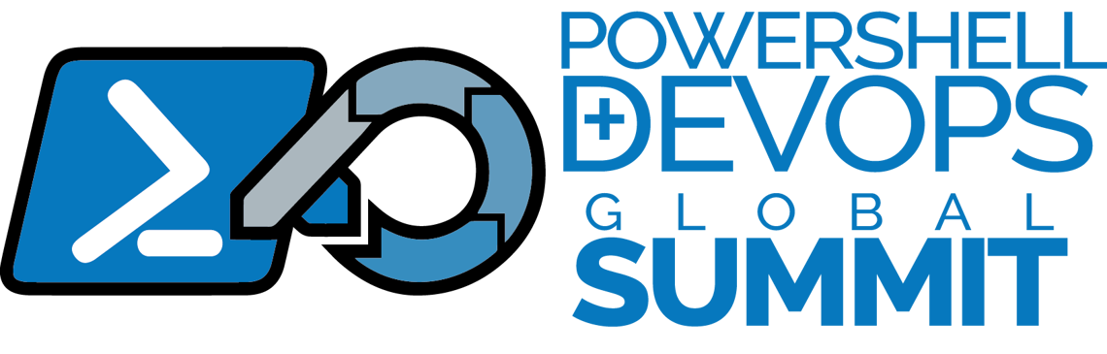

Intro to Azure
Mike F. Robbins
@mikefrobbins
April 8-11, 2024

Slide 2




Get-Help –Name 'about_Presenter'
Mike F. Robbins
Lead docs writer for Azure PowerShell at Microsoft

Slide 3
Cloud Computing
Delivery of computing services—including servers, storage, databases, networking, software, analytics, and intelligence—over the internet (“the cloud”)
Top Benefits
Cost-Effective
Global Scale
Performance
Security
Speed and Agility
Productivity
Reliability
Notes:
Cloud computing is a technology that allows individuals and organizations to access and use computing resources (like servers, storage, databases, networking, software, analytics, and intelligence) over the internet, often referred to as "the cloud." This technology offers several key advantages:
1. **Cost-Effective:** It eliminates the capital expense of buying hardware and software and setting up and running on-site data centers—the racks of servers, the round-the-clock electricity for power and cooling, and the IT experts for managing the infrastructure.
2. **Global Scale:** The benefits of cloud computing services include the ability to scale elastically. In cloud speak, that means delivering the right amount of IT resources—for example, more or less computing power, storage, bandwidth—exactly when it's needed and from the right geographic location.
3. **Performance:** The biggest cloud computing services run on a worldwide network of secure data centers, which are regularly upgraded to the latest generation of fast and efficient computing hardware. This offers several benefits over a single corporate data center, including reduced network latency for applications and greater economies of scale.
4. **Speed and Agility:** With cloud computing, vast amounts of computing resources can be provisioned in minutes, typically with just a few mouse clicks, giving businesses a lot of flexibility and taking the pressure off capacity planning.
5. **Productivity:** On-site datacenters typically require a lot of “racking and stacking”—hardware set up, software patching, and other time-consuming IT management chores. Cloud computing removes the need for many of these tasks, so IT teams can spend time on achieving more important business goals.
6. **Reliability:** Cloud computing makes data backup, disaster recovery, and business continuity easier and less expensive because data can be mirrored at multiple redundant sites on the cloud provider’s network.
7. **Security:** Many cloud providers offer a set of policies, technologies, and controls that strengthen your security posture overall, helping protect your data, apps, and infrastructure from potential threats.
Overall, cloud computing provides a simple way to access servers, storage, databases, and a broad set of application services over the Internet. Cloud providers typically bill for cloud computing services based on usage, similar to how you are billed for water or electricity at home.

Slide 4


Slide 5
Deployment Models
Public Cloud
Hardware, software, and infrastructure are owned by the cloud provider
Private Cloud
Resources used exclusively by a single business or organization
Hybrid Cloud
Combine public and private clouds
Notes:
The types of clouds in cloud computing can be categorized based on the deployment model, each with its own specific features and use cases. The primary cloud deployment models are:
1. **Public Cloud:** Public clouds are owned and operated by third-party cloud service providers, which deliver their computing resources like servers and storage over the Internet. With a public cloud, all hardware, software, and other supporting infrastructure are owned and managed by the cloud provider. You access these services and manage your account using a web browser. Examples include Amazon Web Services (AWS), Microsoft Azure, and Google Cloud Platform (GCP).
2. **Private Cloud:** A private cloud refers to cloud computing resources used exclusively by a single business or organization. A private cloud can be physically located on the company’s on-site datacenter. Some companies also pay third-party service providers to host their private cloud. A private cloud is one where the services and infrastructure are maintained on a private network, offering more control over the company's data and avoiding the multitenancy of public clouds.
3. **Hybrid Cloud:** Hybrid clouds combine public and private clouds, bound together by technology that allows data and applications to be shared between them. By allowing data and applications to move between private and public clouds, a hybrid cloud gives your business greater flexibility, more deployment options, and helps optimize your existing infrastructure, security, and compliance.
4. **Community Cloud:** A community cloud is a collaborative effort in which infrastructure is shared between several organizations from a specific community with common concerns (security, compliance, jurisdiction, etc.), whether managed internally or by a third-party and hosted internally or externally. This model provides a cloud solution tailored to the specific needs of a group of organizations.
Each type of cloud service and deployment method provides different levels of control, flexibility, and management, enabling users to select the right set of services for their needs.

Slide 6
Types of Cloud Services
IaaS (Infrastructure as a Service)
You rent IT infrastructure: servers, VMs, storage, networks, operating systems
PaaS (Platform as a Service)
A complete cloud platform for developing and running applications without having to maintain the infrastructure
Saas (Software as a Service)
A complete, customer-facing application that runs in the Cloud
Notes:
Cloud computing is categorized into three main types based on the kind of service provided. These types are Infrastructure as a Service (IaaS), Platform as a Service (PaaS), and Software as a Service (SaaS). Each type offers different levels of control, flexibility, and management, catering to various business needs:
1. **Infrastructure as a Service (IaaS):** This is the most basic category of cloud computing services. With IaaS, you rent IT infrastructure—servers and virtual machines (VMs), storage, networks, operating systems—from a cloud provider on a pay-as-you-go basis. IaaS provides users with the highest level of flexibility and management control over their IT resources. It's similar to having a virtual data center with access to many of the same technologies and capabilities of a physical data center without the physical management. Examples include Amazon Web Services (AWS) EC2, Google Compute Engine (GCE), and Microsoft Azure VMs.
2. **Platform as a Service (PaaS):** This type of cloud computing delivers hardware and software tools—usually those needed for application development—to users as a service. A PaaS provider hosts the hardware and software on its own infrastructure. Thus, PaaS frees users from having to install in-house hardware and software to develop or run a new application. PaaS is designed to support the complete web application lifecycle: building, testing, deploying, managing, and updating. Examples include Microsoft Azure App Services, Google App Engine, and AWS Elastic Beanstalk.
3. **Software as a Service (SaaS):** SaaS provides a complete software solution that you purchase on a pay-as-you-go basis from a cloud service provider. You rent the use of an app for your organization, and your users connect to it over the Internet, usually with a web browser. All the underlying infrastructure, middleware, app software, and app data are located in the service provider’s data center. SaaS allows your organization to get quickly up and running with an app at minimal upfront cost. Common examples include Google Workspace, Microsoft 365, and Salesforce.
In addition to these, there are variations and combinations of these services, like Function as a Service (FaaS), which is often associated with serverless computing, where developers can execute code in response to events without the complexity of building and maintaining the infrastructure.
Understanding these types allows organizations to choose the right service model for their needs, balancing control, flexibility, and ease of use.

Slide 7
What is Azure?
A cloud computing service created by Microsoft for:
Building
Testing
Deploying
And Managing
Applications and Services
Through Microsoft-managed data centers
Notes:
Microsoft Azure, often simply called Azure, is a cloud computing service created by Microsoft for building, testing, deploying, and managing applications and services through Microsoft-managed data centers. It provides a wide range of cloud services, including those for computing, analytics, storage, and networking. Users can pick and choose from these services to develop and scale new applications or run existing applications in the public cloud.
The key features of Azure include:
1. **Computing**: Azure provides virtual machines, container services, and service fabric, which can support various computing needs and allow users to deploy and manage virtualized applications.
2. **Storage**: Azure offers scalable cloud storage solutions, including blob storage, disk storage, and file storage, ensuring high availability and durability for data storage.
3. **Networking**: Azure provides a variety of networking features like Azure Virtual Network, VPN Gateway, and Azure ExpressRoute, which help in creating secure and reliable network connections.
4. **Databases**: Azure supports multiple types of databases, such as SQL Database, Cosmos DB, and Azure Database for MySQL, providing managed database services with high availability.
5. **AI and Machine Learning**: Azure includes services like Azure Machine Learning, Cognitive Services, and Bot Services, facilitating the development and deployment of AI and machine learning models.
6. **IoT**: Azure IoT services enable users to connect, monitor, and manage billions of IoT assets.
7. **DevOps**: Azure provides tools that support a complete DevOps lifecycle, like Azure DevOps and Azure DevTest Labs.
8. **Security**: Azure has built-in security features that help protect data, applications, and infrastructure from potential threats.
9. **Compliance**: Azure complies with a broad set of international and industry-specific compliance standards, such as GDPR, HIPAA, ISO 27001, and FedRAMP.
Azure is designed to be flexible and open, supporting a broad range of operating systems, programming languages, frameworks, databases, and devices. This versatility makes it a popular choice for businesses of all sizes, as it allows them to use the tools and technologies they are already familiar with.

Slide 9
Key Azure Features
Compute
VMs, container services, and service fabric
Storage
Blob storage, disk storage, file storage
Networking
Azure Virtual Network, VPN Gateway, Azure EpressRoute
Databases
SQL, Cosmos DB, MySQL, etc
AI and Machine Learning
Machine Learning, Cognitive Services, Bot Services, etc
IoT (Internet of Things)
Connect, monitor and manage IoT assets
DevOps
Tools to support the DevOps lifecycle like Azure DevOps and Azure DevTest Labs
Security
$1 billion investment per year in security to protect customers’ data from cyber threats
Compliance
90+ compliance offerings– the most extensive portfolio in the industry

Slide 10

Start-Process 'Demo'
Demo Code: github.com/mikefrobbins/Presentations

Slide 11
Get-Contact –Identity 'Presenter'
Blog: mikefrobbins.com
Twitter: @mikefrobbins
LinkedIn: www.linkedin.com/in/mikefrobbins
GitHub: github.com/mikefrobbins

